Slide 1
Pacman remake
Kinnear justin wong
Muhammad Salihin bin zaol-kefli
Fong zhi zhong

Slide 2
Game idea
Unity
Windows/ Mac / Linux
Remake of Pac-Man in 3D
3rd person View
Different AI from the original game

Slide 3
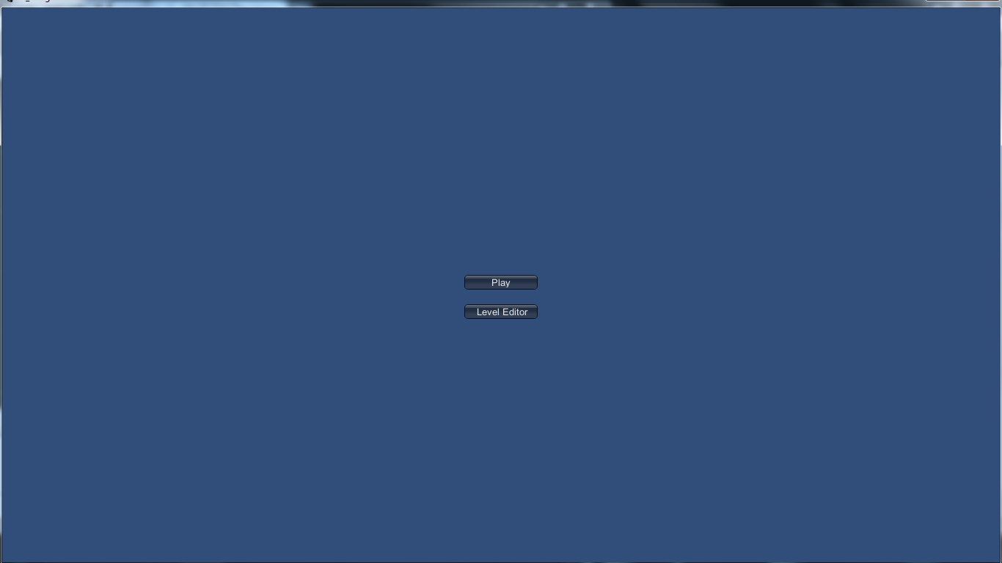
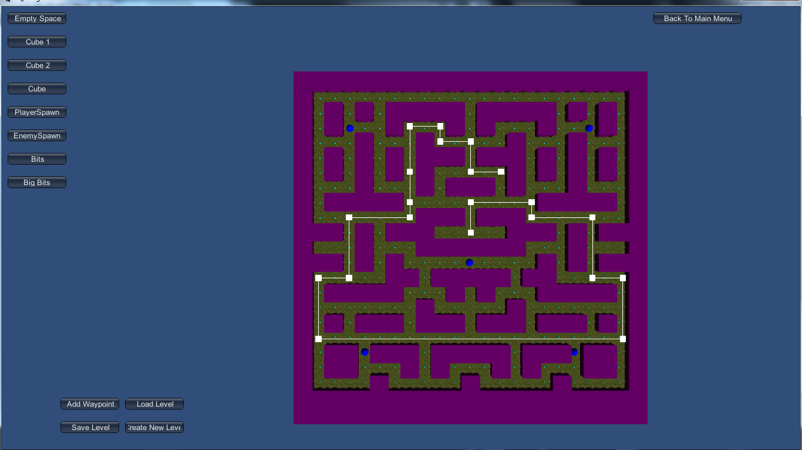
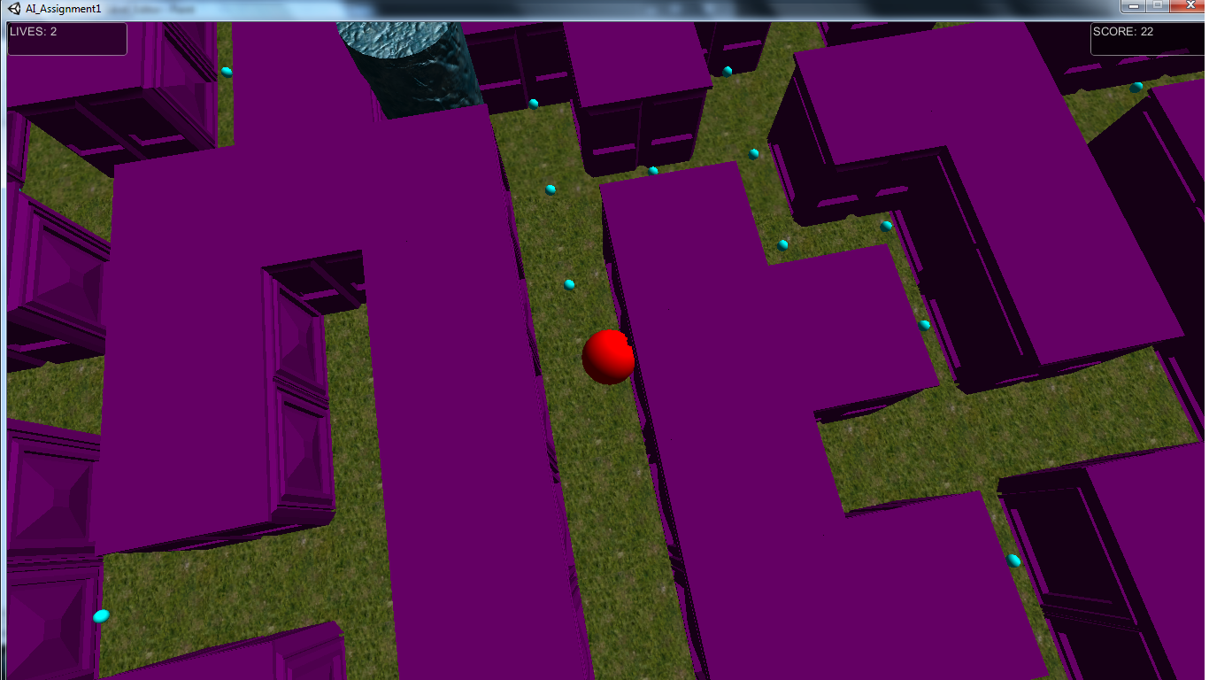
Game screenshots

Slide 4
Types of ai
Waypoints
A* AI (Random Movement)
A* AI (Chasing Within Range)
A* AI (Chasing)
Dijkstra AI (Chasing)

Slide 5
Waypoint ai
Waypoints are set in the level’s corresponding waypoint level text file
Stored into a list for the AI to traverse through

Slide 6
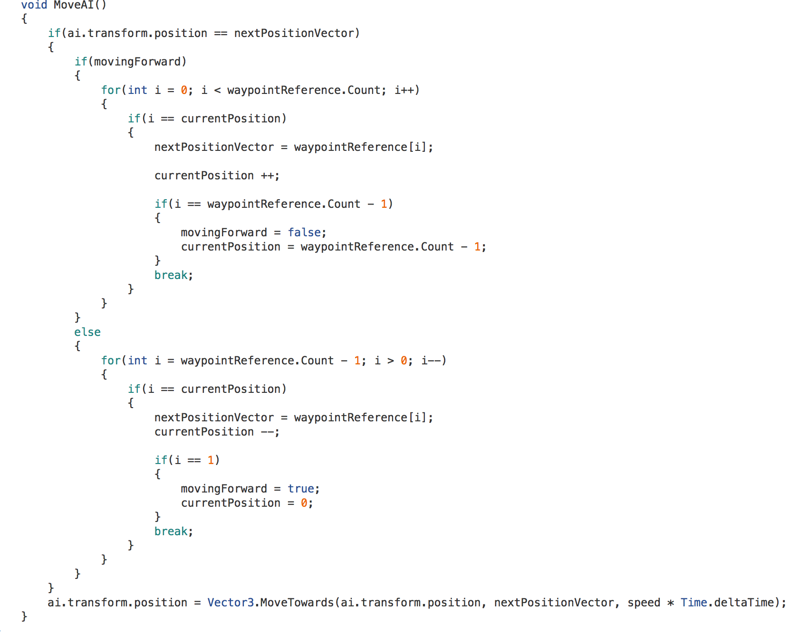
Waypoint ai
MoveAI() is to traverse through the list of waypoints that were set in the Level Editor in the particular level
AI “Ping-Pong’s” back and forth towards the AI’s respective positions in the list

Slide 7
A* ai (Random Movement)
AI picks a random spot on the map
Spot is not an environmental tile
Use A* to plot path towards the randomly selected spot

Slide 8
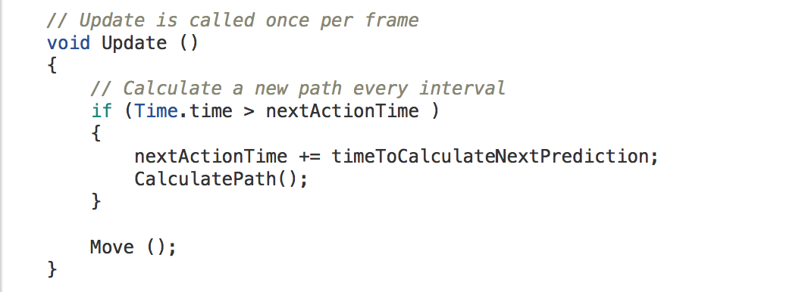
A* ai (Random Movement)
CalculatePath() runs at an interval set in the Unity Editor
CalculatePath() is to calculate the desired path of the AI towards a target by the A* algorithm
Move() moves the AI towards targeted positions in the list of nodes stored

Slide 9
A* ai (Chasing Within range)
Take effect only when Pac – Man is within range
Pac – Man’s position is set as the AI’s destination
Use A* to plot a path from the AI’s current position to the destination

Slide 10
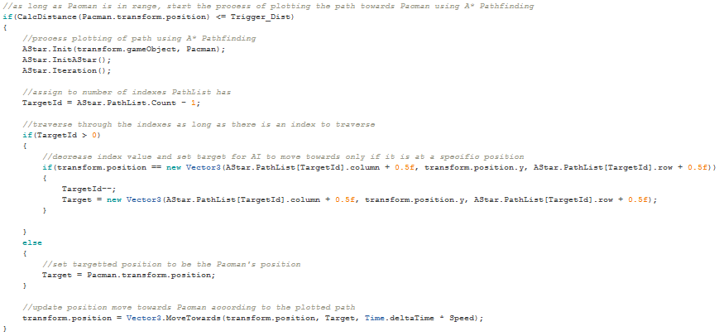
A* ai (Chasing Within range)
CalcDistance() calculates the distance between the AI and the Player
AStar.Init() takes in the data of the AI and the Player and manipulates them for use in A* Pathfinding
AStar.InitAStar() adds the current tile the AI is in to the OpenList
AStar.Iteration()performs the iteration to add tiles into OpenList and CloseList and to plot path from AI to Pacman

Slide 11
A* ai (Chasing)
Uses A* Algorithm to calculate path
Pass in array of Game Objects as Graph
Pass in Start Point in Source.
Pass in End Point in Target
Returns a stack of GameObjects for movement

Slide 12
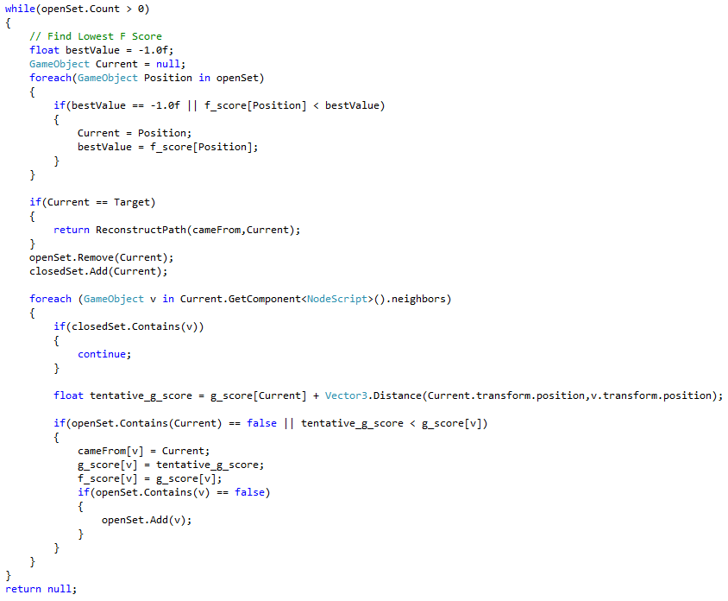
A* ai (Chasing)

Slide 13
Dijkstra ai (Chasing)
Uses Dijkstra Algorithm to calculate path
Pass in array of Game Objects as Graph
Pass in Start Point in Source
Pass in End Point in Target
Returns a stack of GameObjects for movement

Slide 14
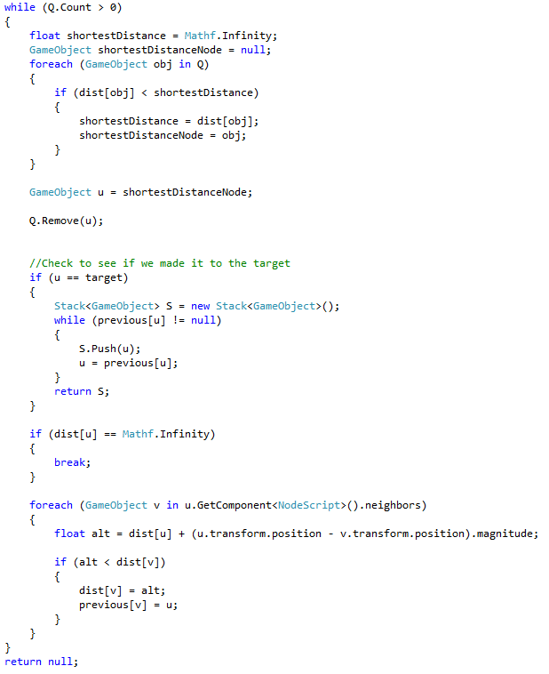
Dijkstra ai (Chasing)

Slide 15
demo

